Slide 1
Sparks Piranhas
Everything you need to know about swim meets…
…and then some

Slide 2
When is my swimmer ready for a meet?
Ask your swimmer’s coach if your swimmer is ready for a meet
My swimmer is ready for a meet…Now what?

Slide 3
Signing Up for a meet
Visit the team website
Sparkpiranhasaquatics.com
for the current meet and event schedule
The following is the link/address to the schedule
schedulehttp://www.sparkspiranhasaquatics.com/meet-and-event-schedule
Once a swim meet is open for registration you can follow the link on the website or visit
www.Ome.swimconnection.com to sign up
Once your swimmer is ready for competition you will need to choose a meet to attend. Your swimmer’s coach will tell you which meet will be best suited for a positive outcome for your swimmer.

Slide 4
What is Swim connection?

Slide 5
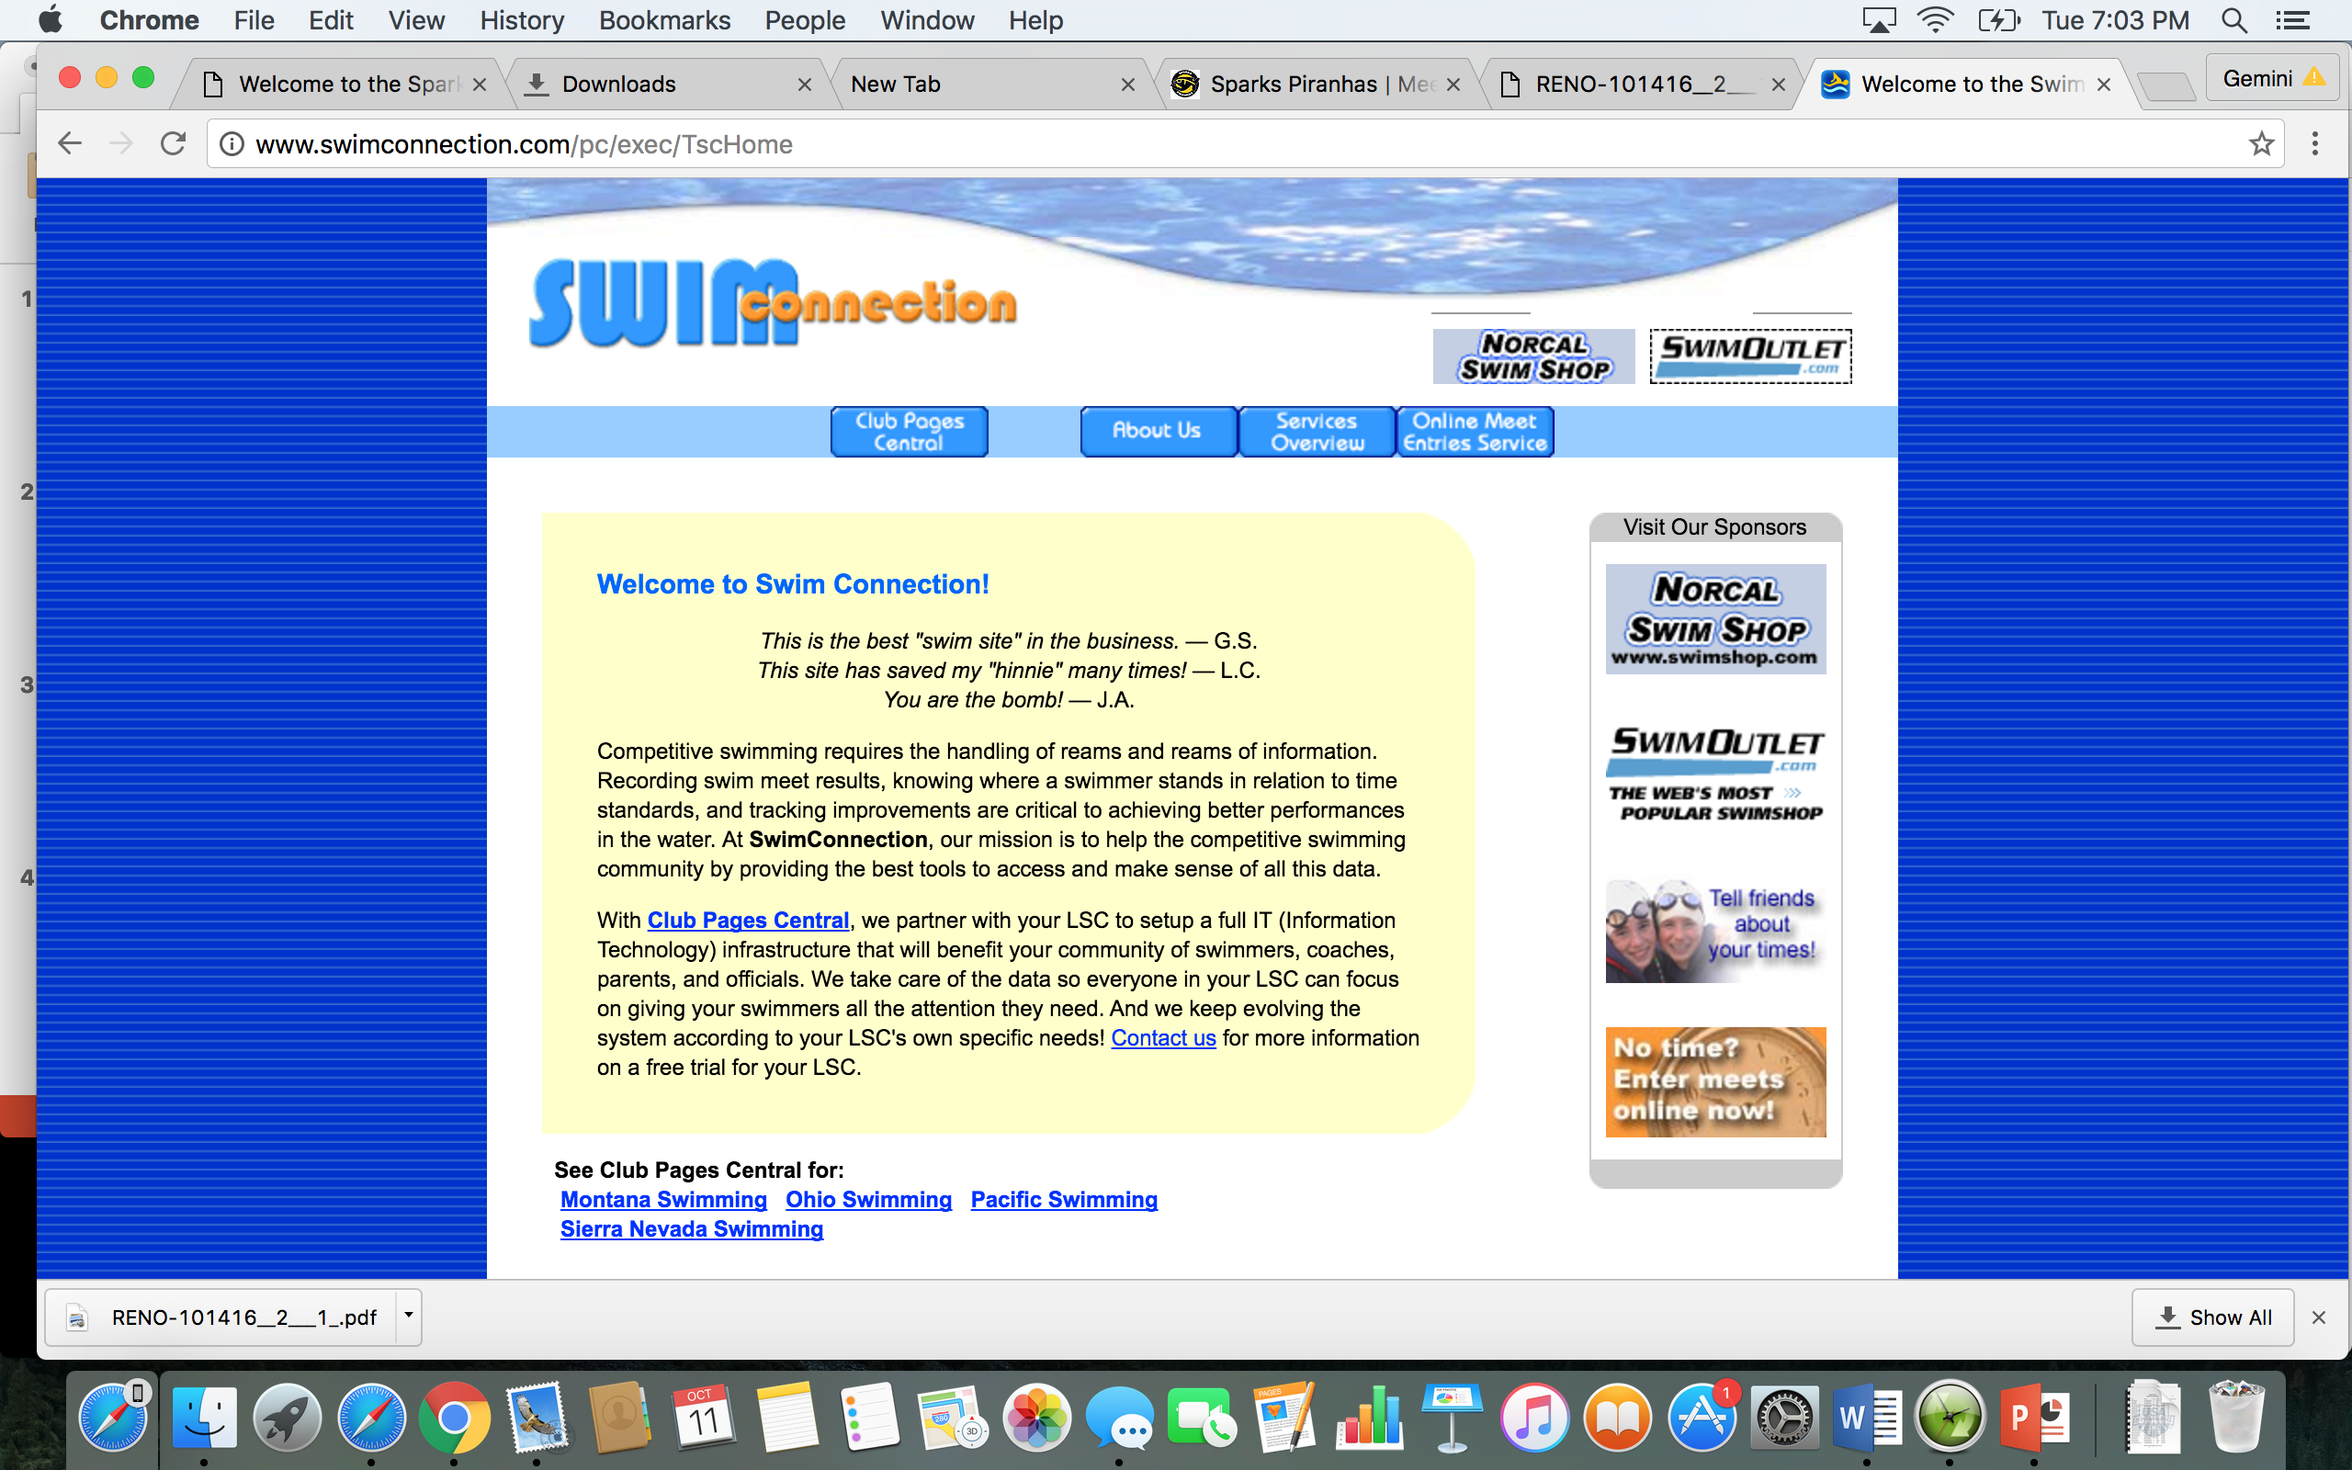
Create a swim connection account
As a member of Sparks Piranhas, your swimmer is a member of USA Swimming
The Sparks Piranhas are a member of the Sierra Nevada lsc, a sub group of usa swimming
When registering our team code is SPKS and our LSC code is SN
Once this account is created your swimmers results will be stored and you can access them as well as other time standards

Slide 6
Create an ome.swimconnection.com account
ome stands for online meet entry. This is the website used to enter most of the meets we go to
Announcements will be made if a meet needs a different form of entry
Go to the website below and create an account
Once your account is created, you can enter meets
Go to or click on the link below to get started
https://ome.swimconnection.com/

Slide 7
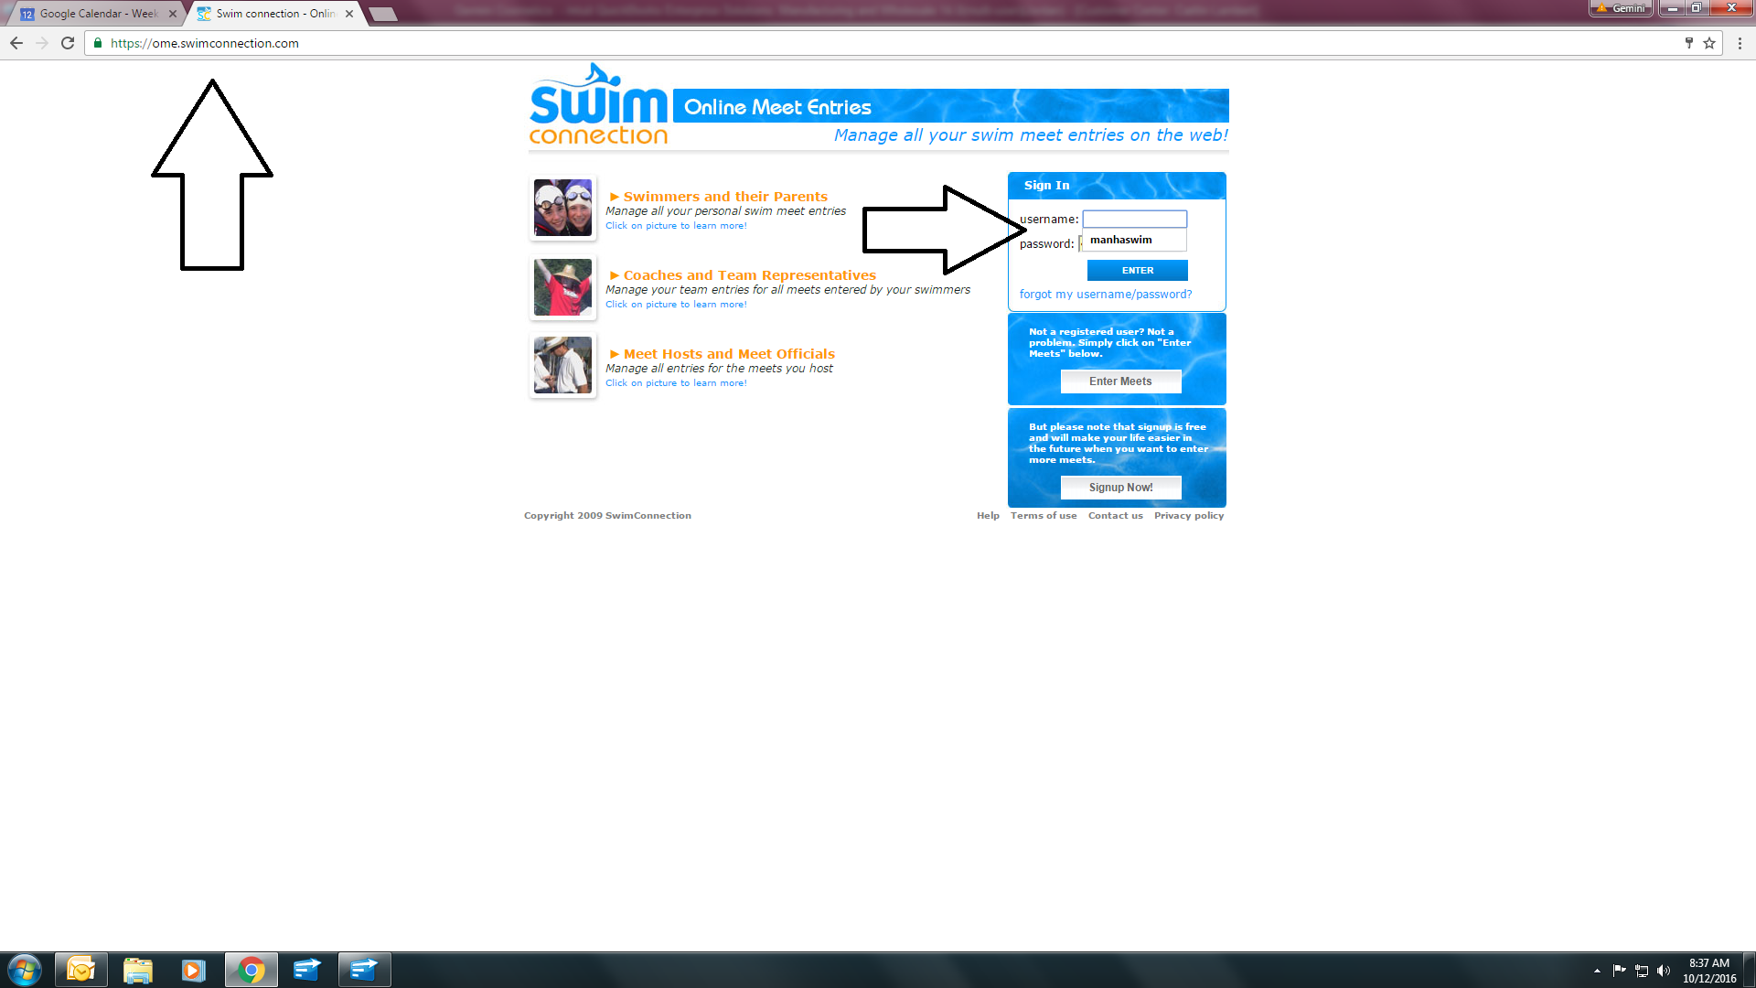
Go to the ome.swimconnection.com website and create your account

Slide 8
Next chose the swim meet to enter

Slide 9
Click on the meet sheet

Slide 10
What does the meet sheet tell you?
When and where the meet is
What time the meet starts each day
What session you swimmer is in - meets are usually split by age group in a morning or afternoon session, or by trials and finals in a championship meet
How many events your swimmer can swim each day
Any other special instructions related to the meet
After you have read the meet sheet, consult with the coach to see what is best for your swimmer to swim
Enter your swimmer in the meet and pay for the events
Swim meets do have a max. capacity, so enter quickly if the meet is open for entries

Slide 11
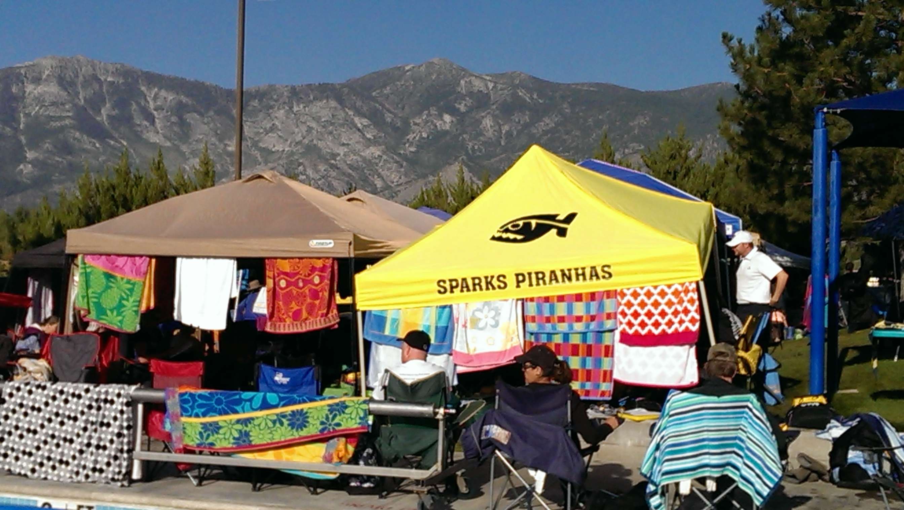
You’ve entered the meet, now what?
the real fun begins

Slide 12
What to bring
Chairs
Wagon to carry things
Blankets
Towels
A mat or tarp for the ground
Extra Clothes for your athlete, they must be dressed at all times, even when it’s hot!
A shade tent if you have one, if not we like to share and be cozy!
Sunscreen
Sharpie
Extra goggles & cap
Sweats, socks, boots
What Food and drinks to pack?
Quick & easy grab and go snacks are best
Water or 50% water/50% sports drink
fruits and veggies
Hummus, cheese, peanut butter
Bagel and cream cheese
Jerky
Cut a sandwich into ¼’s for easy snacks between races
Hard boiled eggs
Yogurt/pudding
applesauce
Stay away from high fat and sugar items that the snack bar offers, its all bad

Slide 13
It’s meet day What to expect?
Check the meet sheet for warm-up times, arrive 15 minutes before warm-ups begin
Your swimmer will need to check in with “clerk of the course” when you arrive. This is usually a table with mass amounts of kids
Swimmer’s will write their events on their hand or arm
Next look for familiar faces and get settled with other team members
The coaches will be on the side of the pool usually under a tent and at a table, have your swimmer check in with the coaches

Slide 14
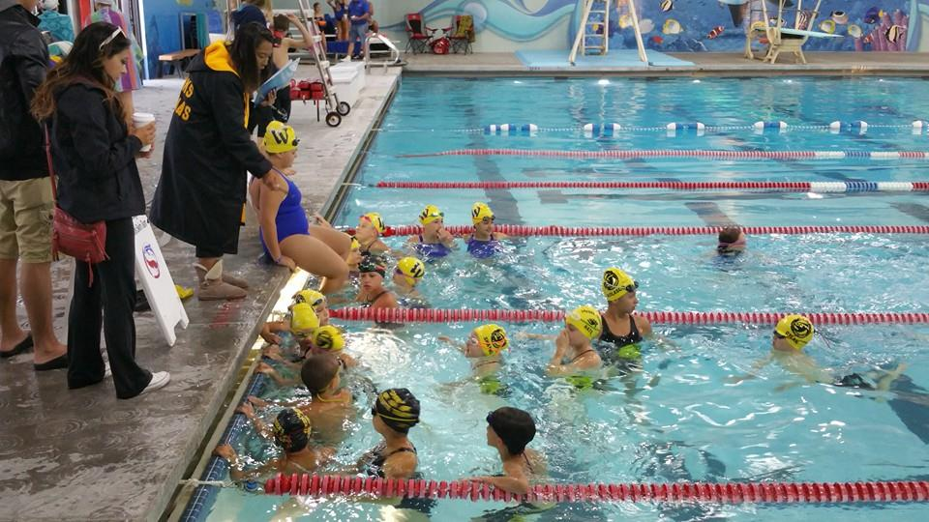
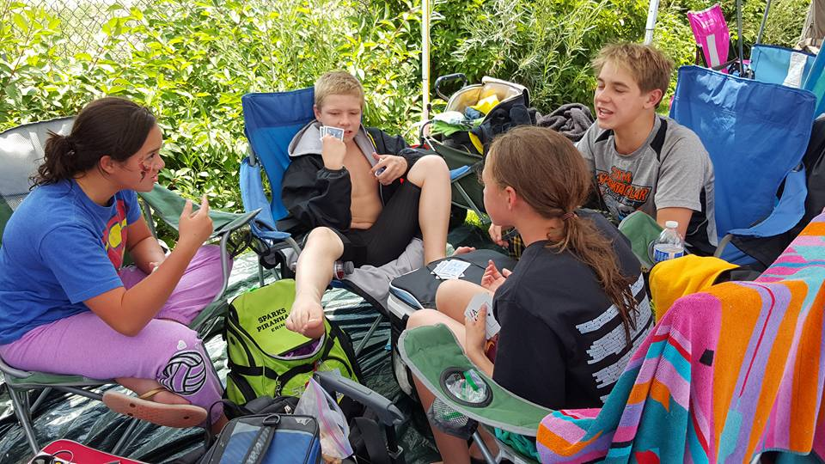
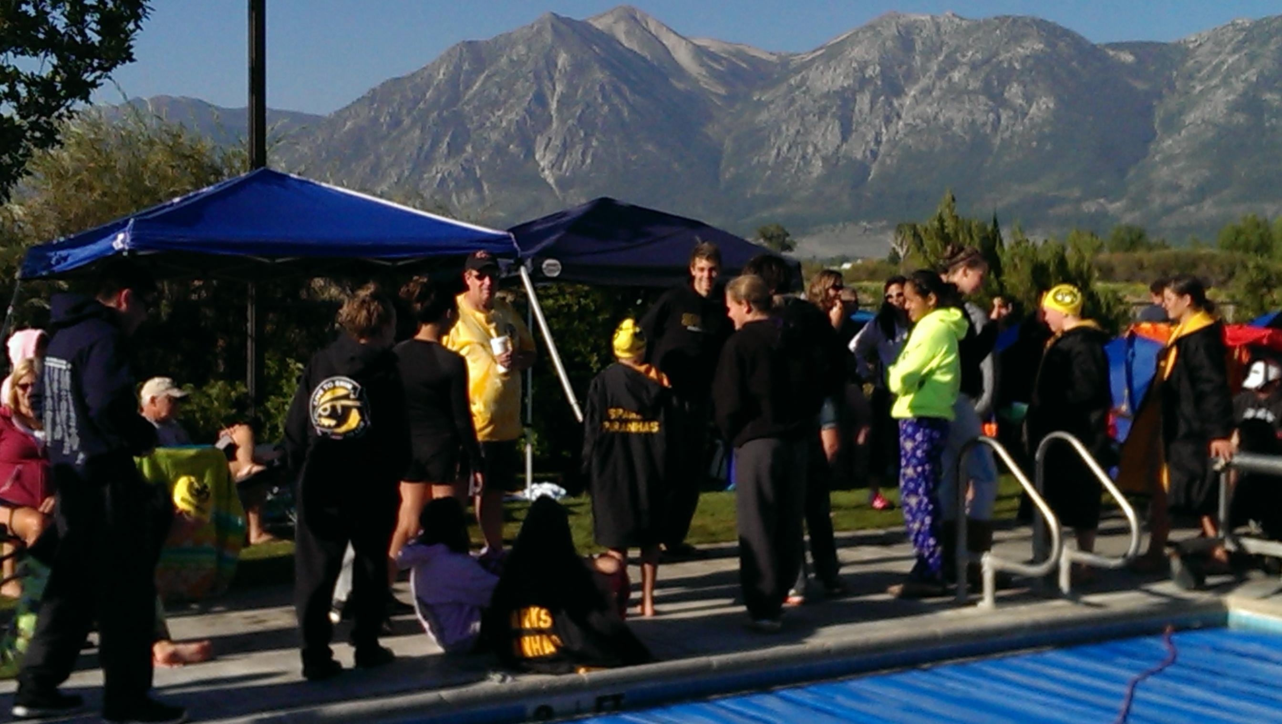
Warm-ups and then what?
The coaches will lead the warm-ups
Then your swimmers will need to get dry and warm
Some stretching and a pep talk from the coaches

Slide 15
Ready to race
Have your swimmer check in with the coach before and after each race
Listen to the announcing and watch for event heat and lane posting
Then give them a drink and a snack and get ready to do it again

Slide 16
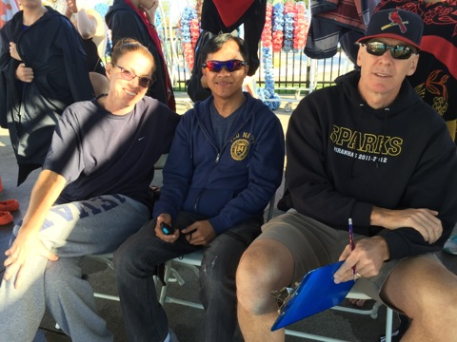
Timing at swim meets
Timing is a responsibility of all members of the team at each session of each meet attended
Timing is a great way to get to know other families
Never timed before, no problem! Sign up with another seasoned family to learn the ropes. It’s literally just pushing a button!
Sign ups are at the coaches table
It is our responsibility to fill those seats so no spot can be left un-filled

Slide 17
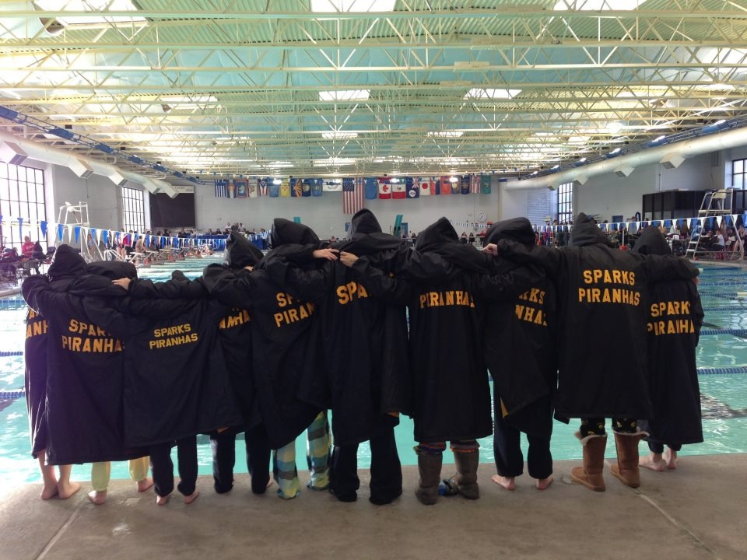
Swim meets are where all the hard work pays off…memories for a lifetime

Slide 18
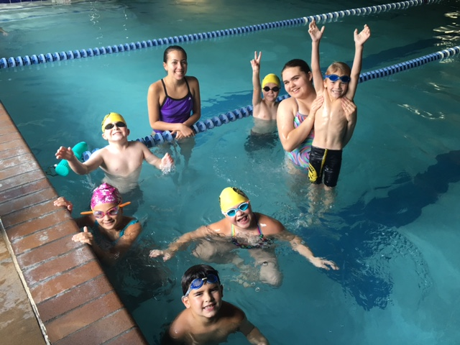
Handy links and information
USA Swimming- usaswimming.org
Sierra Nevada Swimming-sn-swimming.org
Sparks Piranhas-sparkspiranhasaquatics.com
Online meet entry-ome.swimconnection.com
Swim Connection-swimconnection.com
Sparks Piranhas Aquatics Twitter- Sparks_Piranhas
Sparks Piranhas Aquatics Facebook – Sparks Piranhas Aquatics
Sparks Piranhas Aquatics Instagram-sparkspiranhaaquatics

